Slide 1

Python for QA
Introduction to Python

Slide 2
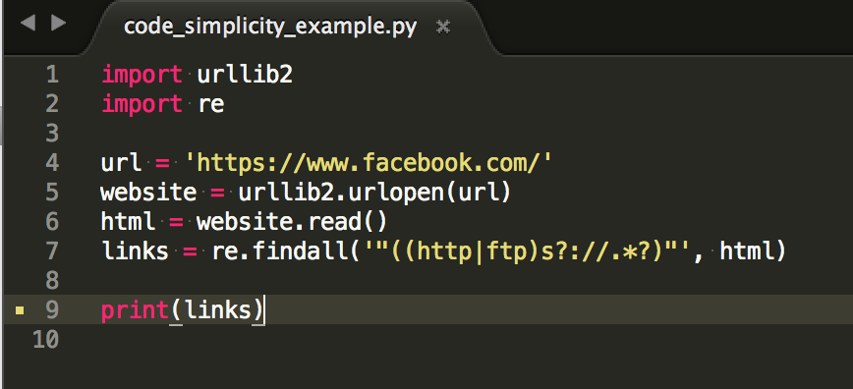
Why Python?
Code readability
Obvious simplicity
Open extensibility
Cross-platform runnability
Humanity
Notes:
http://radar.oreilly.com/2015/04/five-reasons-why-python-is-a-popular-teaching-language.html

Slide 3
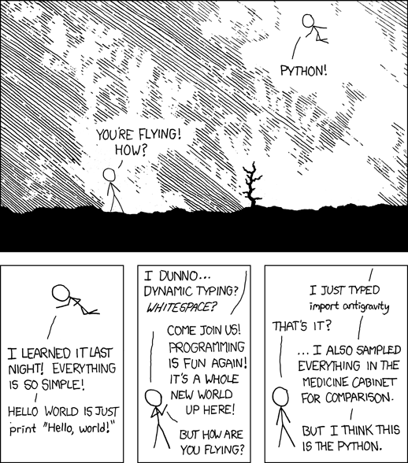
Import Antigravity
Notes:
https://www.explainxkcd.com/wiki/index.php/353:_Python
https://www.python.org/doc/humor/
A little girl goes into a pet show and asks for a wabbit. The shop keeper looks down at her, smiles and says: "Would you like a lovely fluffy little white rabbit, or a cutesy wootesly little brown rabbit?" "Actually", says the little girl, "I don't think my python would notice." —Nick Leaton, Wed, 04 Dec 1996

Slide 4
The Zen of Python
Beautiful is better than ugly. Explicit is better than implicit. Simple is better than complex. Complex is better than complicated. Flat is better than nested. Sparse is better than dense. Readability counts. Special cases aren't special enough to break the rules. Although practicality beats purity. Errors should never pass silently. Unless explicitly silenced. In the face of ambiguity, refuse the temptation to guess. There should be one-- and preferably only one --obvious way to do it. Although that way may not be obvious at first unless you're Dutch. Now is better than never. Although never is often better than *right* now. If the implementation is hard to explain, it's a bad idea. If the implementation is easy to explain, it may be a good idea. Namespaces are one honking great idea -- let's do more of those!
Notes:
import this

Slide 5
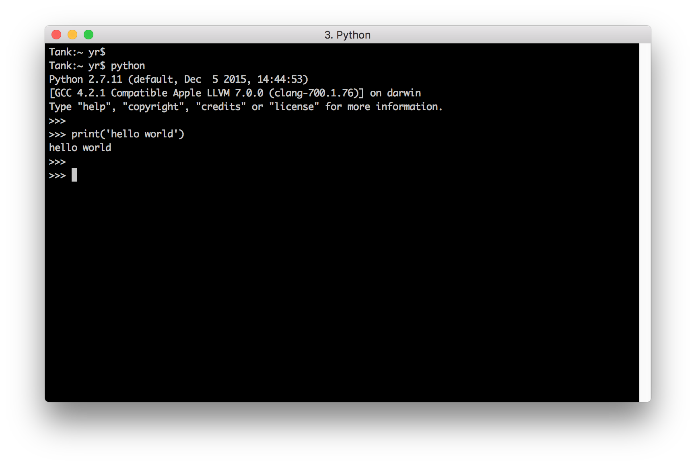
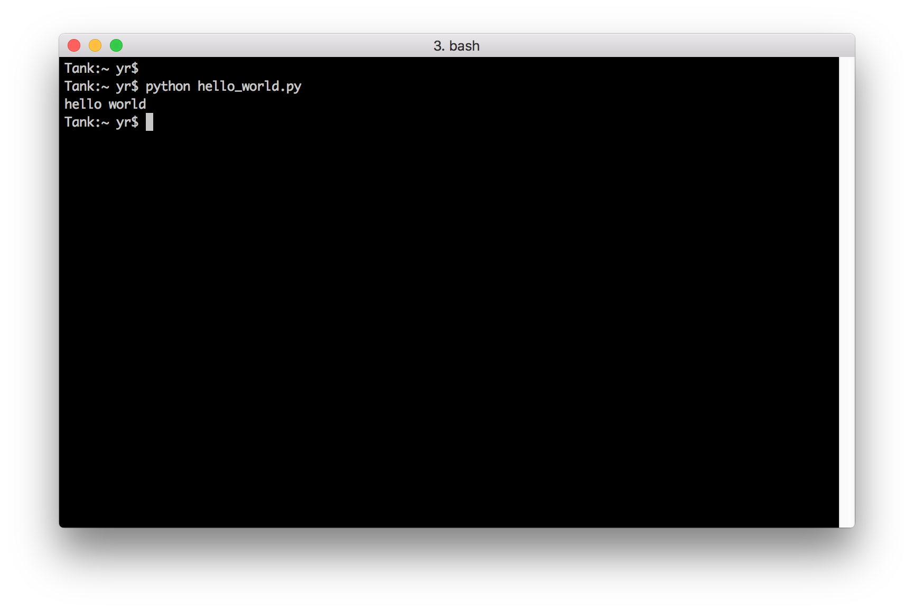
Python Interpreter

Slide 6

Python Ecosystem
Python 2.7 vs Python 3.x
Packages
PYTHONPATH
Third party packages
PyPI
pip
Notes:
http://mirnazim.org/writings/python-ecosystem-introduction/

Slide 7
Development Environment
virtualenv
virtualenv --distribute .env
source .env/bin/activate
source .env/bin/deactivate
virtualenvwrapper
mkvirtualenv <env_name>
workon <env name>
deactivate
rmvirtualenv <env_name>
pip
pip freeze -l > requirements.txt
pip install -r requirements.txt
Notes:
virtualenv and virtualenvwrapper

Slide 8
Practice
Run Python in interactive mode
Run script using Python
Run script in PyCharm
Create virtual environment
Install packages using pip
Freeze environment
Setup required packages from requirements.txt
Notes:
Linux or Windows?

Slide 9
Summary

Slide 10
Keywords
print

Slide 11
Useful
Python documentation
Install virtualenv
Python development environment on Windows
Introduction to Python
PyPI
Python examples
Notes:
http://docs.python-guide.org/en/latest/dev/virtualenvs/
http://www.tylerbutler.com/2012/05/how-to-install-python-pip-and-virtualenv-on-windows-with-powershell/
https://github.com/yrunts/python-training/blob/master/course/00-intro.rst

Slide 12
Homework
Install Python 2.7
PIP
Install
Add requirements.txt to directory with homeworks
Add dependency to ``request`` package
Install virtualenv and virtualenvwrapper
Create new virtual environment for Python training
Install ``requests`` package from 2.c using pip in virtual environment
Notes:
https://github.com/yrunts/python-for-qa/blob/master/1-introduction-to-python/homework.rst

Slide 13
Questions?

